Slide 1

Subject Code: SCSA1303 Subject Name: Software Engineering

Slide 2

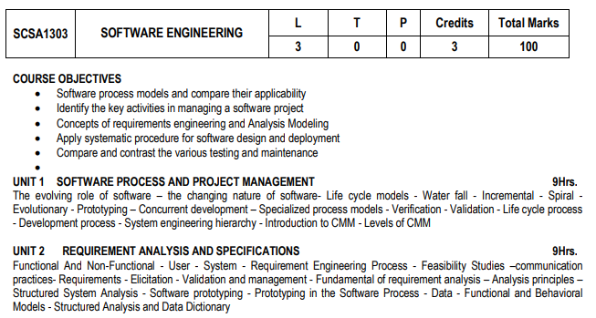

Slide 3
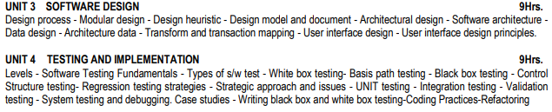

Slide 4
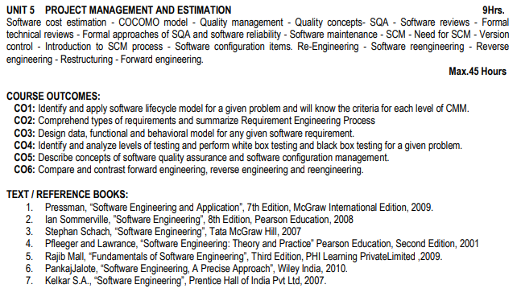

Slide 5
Unit – IV-TESTING AND IMPLEMENTATION
Levels - Software Testing Fundamentals - Types of s/w test - White box testing- Basis path testing - Black box testing -Control Structure testing- Regression testing strategies - Strategic approach and issues - UNIT testing - Integration testing -Validation testing - System testing and debugging. Case studies - Writing black box and white box testing-Coding Practices Refactoring

Slide 6
Software Types
Chrome, firefox, IE, Media Player-Installed Software
Operating System-System Software
Gmail Application, Facebook-Web Application Software Run in the browser

Slide 7
Software Testing
Software Testing is the process of executing a program or system with the intent of finding errors
Software testing is any activity aimed at evaluating an attribute or capability of a program or system and determining that it meets its required results
Testing software is operating the software under controlled conditions, to
(1) verify that it behaves “as specified”
(2) to detect errors
(3) to validate that what has been specified is what the user actually wanted.

Slide 8
Testing Objectives
Testing is a process of executing a program with the intent of finding an error.
A good test case is one that has a high probability of finding an as-yet undiscovered error.

Slide 9
Why Software Testing
Nissan cars recalled over 1 million cars from the market due to software failure in the airbag sensory detectors. There has been reported two accident due to this software failure.
In the mid-2000’s many Toyota drivers were reporting that their car was accelerating without them touching the pedal. After a series of accidents, which lead to investigations, investigators discovered that software errors were the cause of the unintended acceleration.
Some of Amazon's third-party retailers saw their product price is reduced to 1p due to a software glitch. They were left with heavy losses.
In 2015 fighter plane F-35 fell victim to a software bug, making it unable to detect targets correctly.
Starbucks was forced to close about 60 percent of stores in the U.S and Canada due to software failure in its POS system. At one point, the store served coffee for free as they were unable to process the transaction.

Slide 10
why Software Testing
China Airlines Airbus A300 crashed due to a software bug on April 26, 1994, killing 264 innocents live
In 1985, Canada's Therac-25 radiation therapy machine malfunctioned due to software bug and delivered lethal radiation doses to patients, leaving 3 people dead and critically injuring 3 others.
In April of 1999, a software bug caused the failure of a $1.2 billion military satellite launch, the costliest accident in history
In May of 1996, a software bug caused the bank accounts of 823 customers of a major U.S. bank to be credited with 920 million US dollars.
St. Mary’s Mercy Hospital It turns out the hospital had recently upgraded its patient-management software system. However, a mapping error in the software resulted in the system assigning a code of 20 (which means “expired”) instead of 01 which meant the patient had been discharged.

Slide 11
why Software Testing
On September 14, 2004, at 5 P.M. air traffic control at the LA airport lost voice communication with approximately 400 airplanes being tracked in the southwestern United States.
In the year 2016, it was discovered that the clinical computer system SystmOne had an error that since 2009 had been miscalculating patient’s risk of heart attack.
On March 18th 2018 a self-driving Uber car that was being tested on the roads of Arizona hit and killed a pedestrian. The backup driver couldn’t react in time to prevent the accident.

Slide 12
Web Application Testing
Usability testing-easy of use
Navigation testing-link properly working-Internal, external
Cookies Testing-small user information [remember password]
Validation Testing-In correct IRCTC all fields are filled
Compatibility Testing-website-Browser-Operating system-Check whether the website is working properly in IE in windows 7,8,10
Localization Testing: amazon.com all in dollars, amazon .in –rupees
Cosmetic errors-spelling mistakes , grammar mistakes, text overlapping
Session Testing: Banking and IRCTC automatically logout. And gmail , facebook session always live.

Slide 13
Testing Principles
All tests should be traceable to customer requirements.
Test should be planned long before testing begins.
The Pareto principle applies to software testing (Pareto principle is a prediction that 80% of effects come from 20% of causes)
eg: The first person to discover this pattern was Vilfredo Pareto, an economist from Italy. He concluded that 80% of all property in Italy belonged to only 20% of the population. “80% of all bugs can be found in 20% of program modules”
Testing should begin ”in the small” and progress toward testing “in the large”.
Exhaustive testing is not possible
To be most effective, testing should be conducted by an independent third party

Slide 14
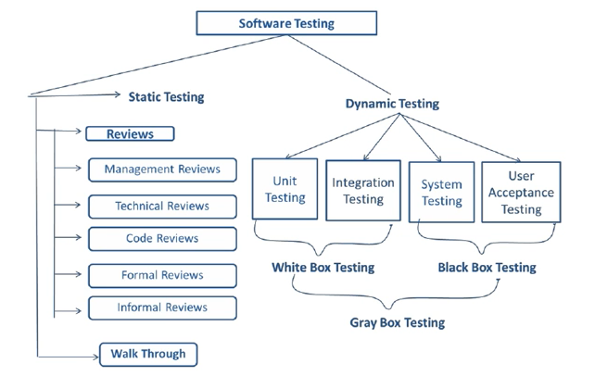
Types of Software Testing

Slide 15
Manual Testing
The process of checking the functionality of an application as per the customer needs without taking any help of automation tools is known as manual testing.
While performing the manual testing on any application, we do not need any specific knowledge of any testing tool, rather than have a proper understanding of the product so we can easily prepare the test document
Manual testing can be further divided into three types of testing, which are as follows:
White box testing
Black box testing
Gray box testing

Slide 16
White Box Testing
It is software testing technique in which internal structure, design and coding of software are tested to verify flow of input-output and to improve design, usability and security.
In white box testing, code is visible to testers so it is also called Clear box testing, Open box testing, Transparent box testing, Code-based testing and Glass box testing.
It is one of two parts of the Box Testing approach to software testing.
Its counterpart, Blackbox testing, involves testing from an external or end-user type perspective.
On the other hand, Whitebox testing is based on the inner workings of an application and revolves around internal testing.

Slide 17
White Box Testing
The term "WhiteBox" was used because of the see-through box concept.
The clear box or WhiteBox name symbolizes the ability to see through the software's outer shell (or "box") into its inner workings.
Likewise, the "black box" in "Black Box Testing" symbolizes not being able to see the inner workings of the software so that only the end-user experience can be tested.

Slide 18
White Box Testing Techniques
Statement Coverage - This technique is aimed at exercising all programming statements with minimal tests.
Branch Coverage - This technique is running a series of tests to ensure that all branches are tested at least once.
Path Coverage - This technique corresponds to testing all possible paths which means that each statement and branch is covered

Slide 19
Statement coverage
In this technique, the aim is to traverse all statement at least once. Hence, each line of code is tested.
In case of a flowchart, every node must be traversed at least once.
Since all lines of code are covered, helps in pointing out faulty code.

Slide 20
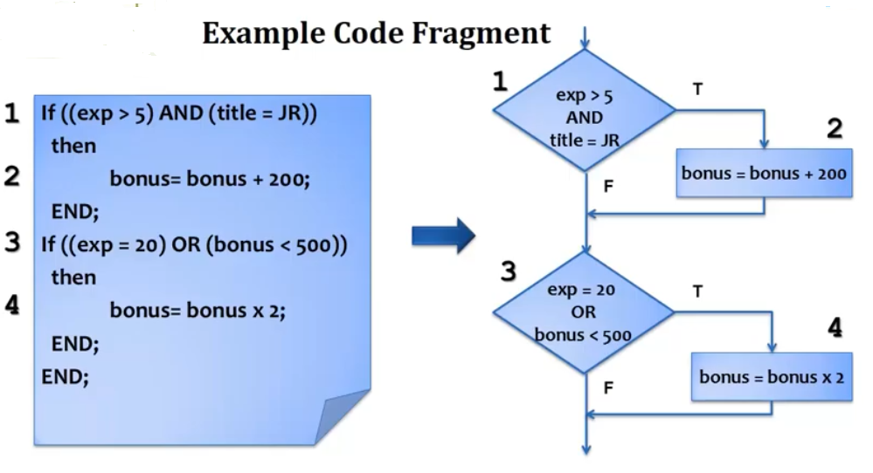
Statement coverage

Slide 21
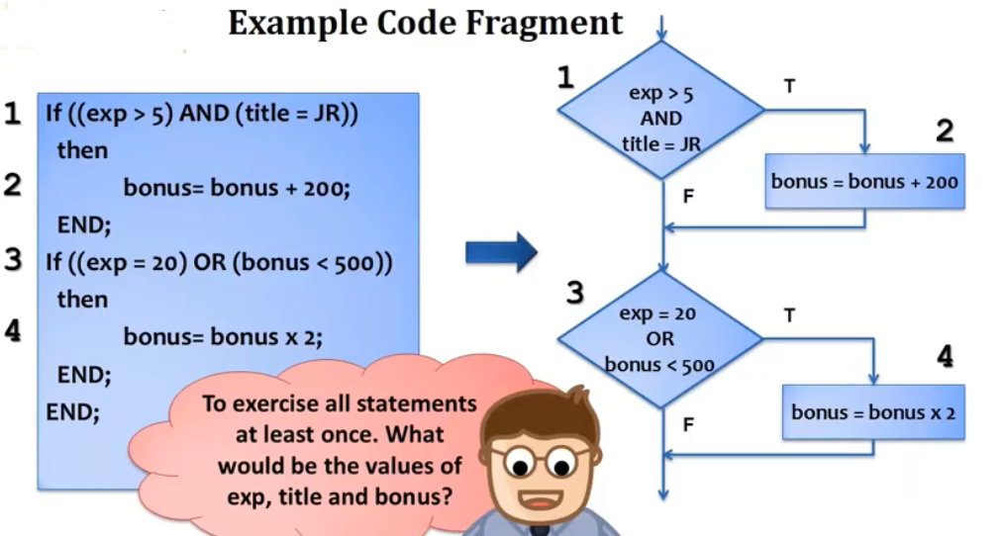
Statement coverage

Slide 22
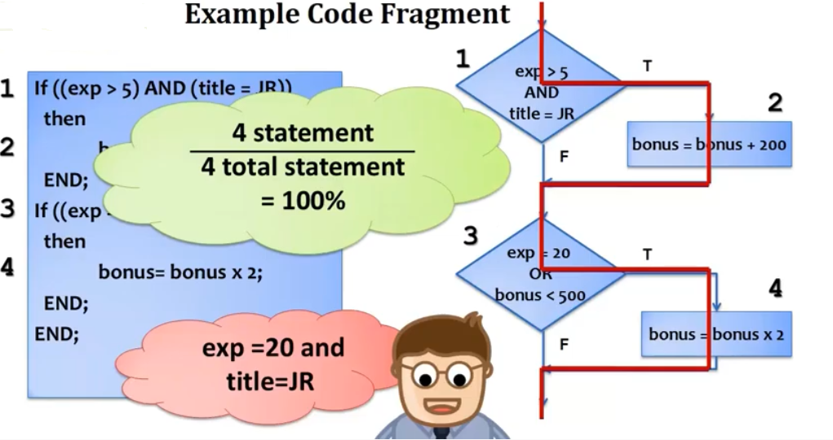
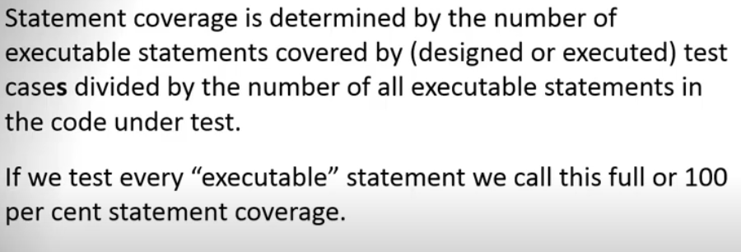
Statement coverage

Slide 23
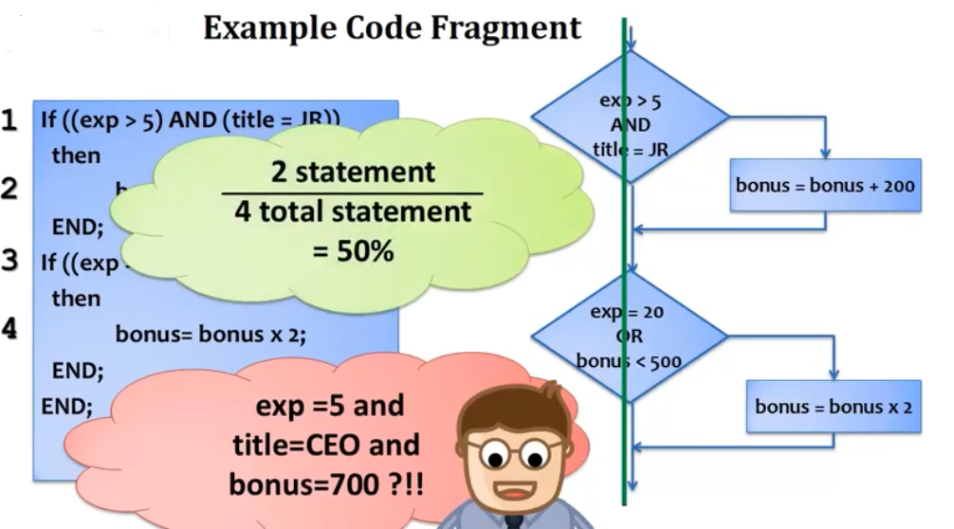
Statement coverage

Slide 24
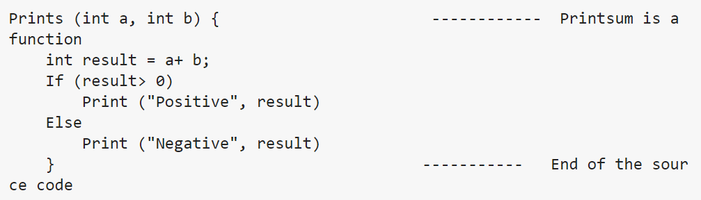
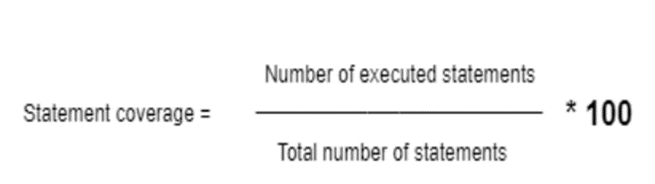
Statement coverage

Slide 25
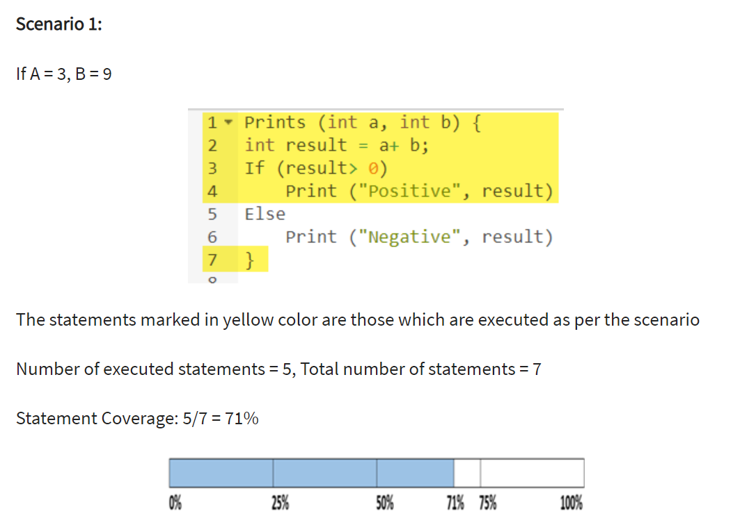
Statement coverage

Slide 26
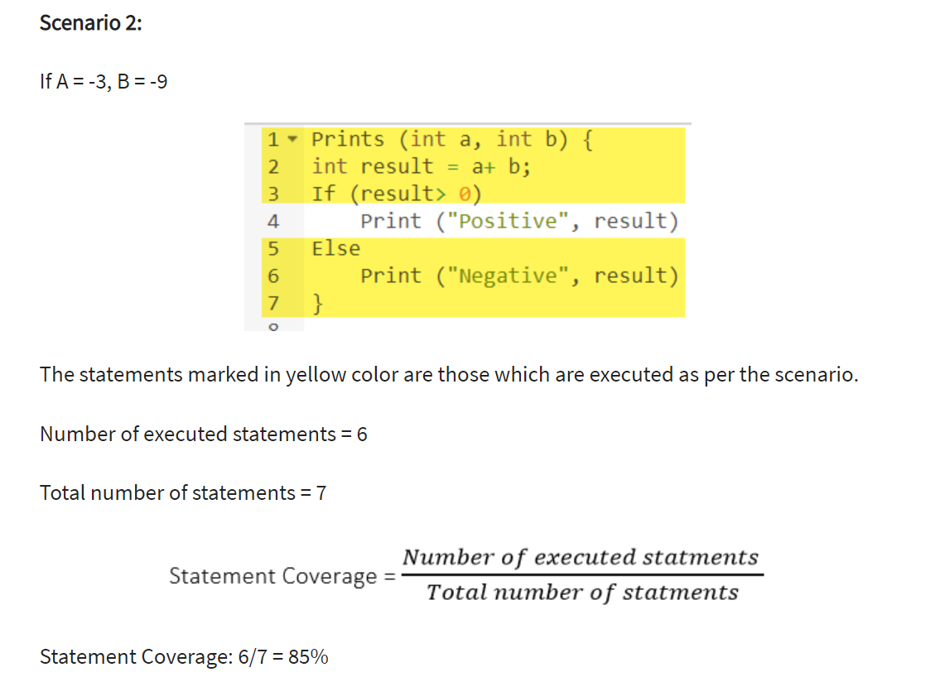
Statement coverage

Slide 27
Statement coverage
Unused Statements
Dead Code
Unused Branches
Missing Statements
Example 2:
To check if number is greater than 50
Read A If A > 50 then print “A is greater than 50” End if
Example 1:
Read A Read B If A > B then x = 0 End if

Slide 28
Branch Coverage
In this technique, test cases are designed so that each branch from all decision points are traversed at least once.
In a flowchart, all edges must be traversed at least once..

Slide 29
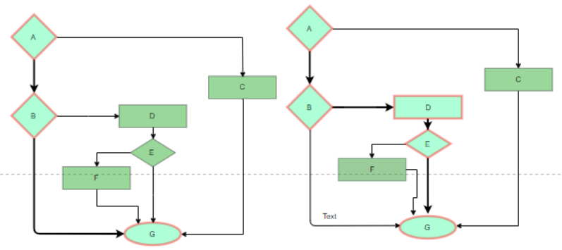
Branch Coverage

Slide 30
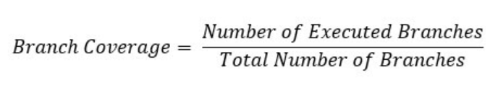
Branch Coverage
Value O/P Branch Coverage
2 2 33%
6 18 67%

Slide 31
Condition Coverage
In this technique, all the possible combinations of the possible outcomes of conditions are tested at least once. Let’s consider the following example:
READ X, Y
IF(X == 0 || Y == 0)
PRINT ‘0’
TC1: X = 0, Y = 0[True, True]
TC2: X = 0, Y = 5[True, False]
TC3: X = 55, Y = 0[False, True]
TC4: X = 55, Y = 5[False, False]
Hence, four test cases required for two individual conditions. Similarly, if there are n conditions then 2^{n} test cases would be required.

Slide 32
Basis Path Testing
In this technique, control flow graphs are made from code or flowchart and then Cyclomatic complexity is calculated which defines the number of independent paths so that the minimal number of test cases can be designed for each independent path.
Steps:
Make the corresponding control flow graph
Calculate the cyclomatic complexity
Find the independent paths
Design test cases corresponding to each independent path

Slide 33
Flow graph notation
It is a directed graph consisting of nodes and edges.
Each node represents a sequence of statements, or a decision point.
A predicate node is the one that represents a decision point that contains a condition after which the graph splits.
Regions are bounded by nodes and edges.

Slide 34
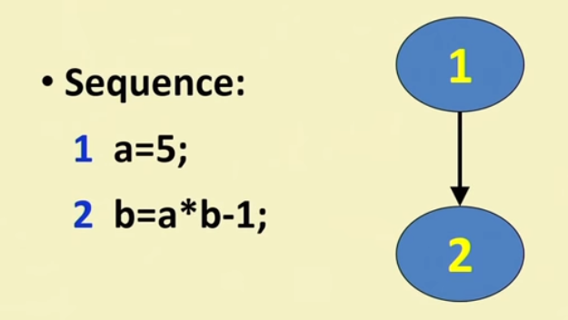
How to Draw Control Flow Graph
Every Program is composed of
-Sequence
-Selection
-Iteration
IF we know how to draw CFG corresponding these basic statements:
-we can draw CFG for any program

Slide 35
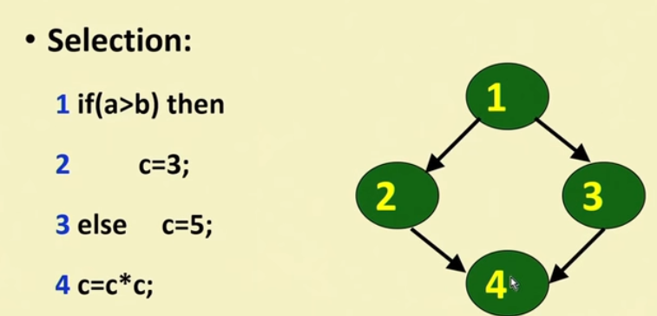
How to Draw Control Flow Graph

Slide 36
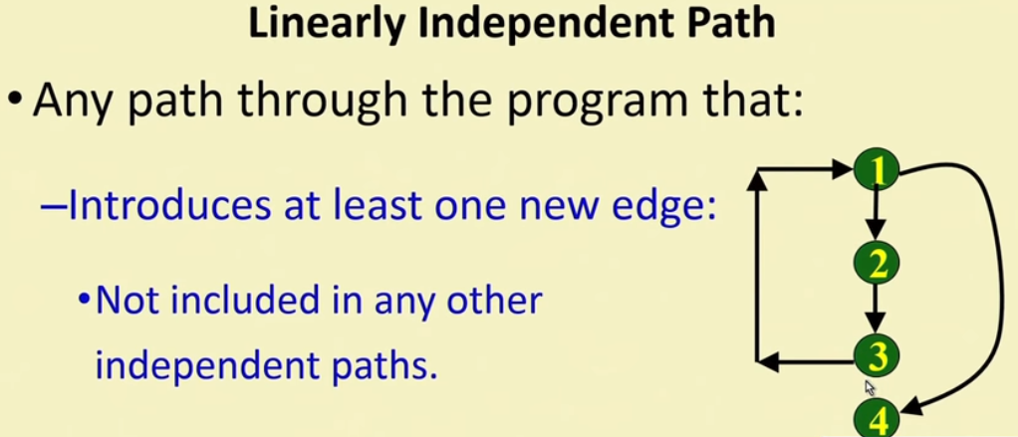
Identification of Linear Independent Path
It is straight forward:
-To identify linear independent paths of simple programs.
For the Complicated Program:
- It is not easy to determine number of independent path

Slide 37
Cyclomatic Complexity
It is a software metric that measures the logical complexity of the program code.
It counts the number of decisions in the given program code.
It measures the number of linearly independent paths through the program code.
Cyclomatic complexity indicates several information about the program code-
Cyclomatic Complexity | Meaning
1 – 10 | Structured and Well Written Code High Testability Less Cost and Effort
10 – 20 | Complex Code Medium Testability Medium Cost and Effort
20 – 40 | Very Complex Code Low Testability High Cost and Effort
> 40 | Highly Complex Code Not at all Testable Very High Cost and Effort

Slide 38
Importance of Cyclomatic Complexity
It helps in determining the software quality.
It is an important indicator of program code’s readability, maintainability and portability.
It helps the developers and testers to determine independent path executions.
It helps to focus more on the uncovered paths.
It evaluates the risk associated with the application or program.
It provides assurance to the developers that all the paths have been tested at least once.

Slide 39
Properties of Cyclomatic Complexity
It is the maximum number of independent paths through the program code.
It depends only on the number of decisions in the program code.
Insertion or deletion of functional statements from the code does not affect its cyclomatic complexity.
It is always greater than or equal to 1.

Slide 40
Calculating Cyclomatic Complexity
Cyclomatic complexity is calculated using the control flow representation of the program code
In control flow representation of the program code,
Nodes represent parts of the code having no branches.
Edges represent possible control flow transfers during program execution
There are 3 commonly used methods for calculating the cyclomatic complexity-

Slide 41
Calculating Cyclomatic Complexity
Method-01:
Cyclomatic Complexity = Total number of closed regions in the control flow graph + 1
Method-02:
Cyclomatic Complexity = E – N + 2
Here-
E = Total number of edges in the control flow graph
N = Total number of nodes in the control flow graph

Slide 42
Calculating Cyclomatic Complexity
Method-03:
Cyclomatic Complexity = P + 1
Here,
P = Total number of predicate nodes contained in the control flow graph
Note-
Predicate nodes are the conditional nodes.
They give rise to two branches in the control flow graph.

Slide 43
PRACTICE PROBLEMS BASED ON CYCLOMATIC COMPLEXITY
Problem-01
Calculate cyclomatic complexity for the given code-
Method-01:
Cyclomatic Complexity
= Total number of closed regions in the control flow graph + 1
= 1+ 1
= 2

Slide 44
PRACTICE PROBLEMS BASED ON CYCLOMATIC COMPLEXITY
Method-02:
Cyclomatic Complexity
= 4 – 4 + 2
= 4 – 4 + 2
= 2

Slide 45
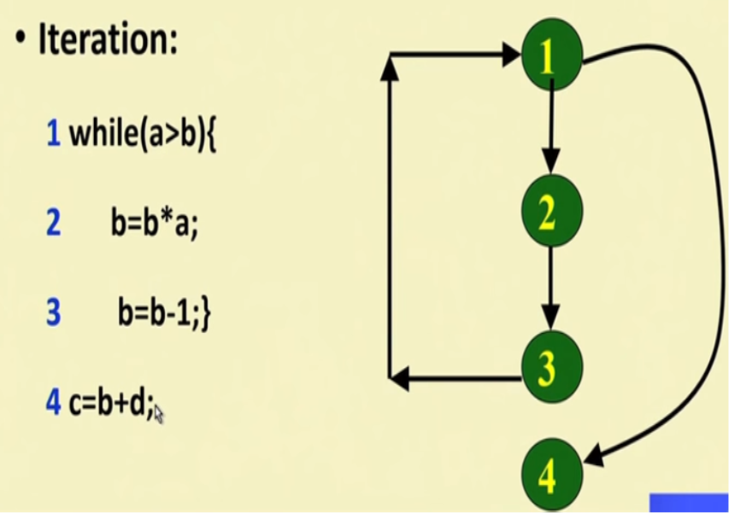
PRACTICE PROBLEMS BASED ON CYCLOMATIC COMPLEXITY
Method-03:
Cyclomatic Complexity
= P + 1
= 1 + 1
= 2

Slide 46
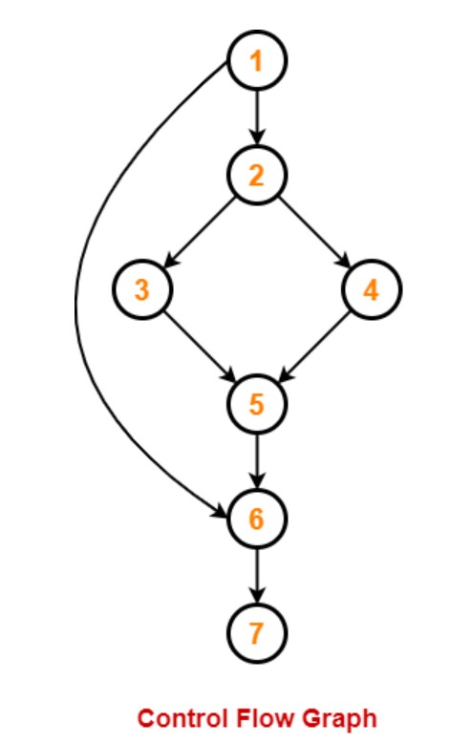
PRACTICE PROBLEMS BASED ON CYCLOMATIC COMPLEXITY
Problem-02
Calculate cyclomatic complexity for the given code-
1. IF A = 354
2. THEN IF B > C
3. THEN A = B
4. ELSE A = C
5. END IF
6. END IF
7. PRINT A

Slide 47
PRACTICE PROBLEMS BASED ON CYCLOMATIC COMPLEXITY
Method-01:
Cyclomatic Complexity
= Total number of closed regions in the control flow graph + 1
= 2 + 1
= 3

Slide 48
PRACTICE PROBLEMS BASED ON CYCLOMATIC COMPLEXITY
Method-02:
Cyclomatic Complexity
= E – N + 2
= 8 – 7 + 2
= 3

Slide 49
PRACTICE PROBLEMS BASED ON CYCLOMATIC COMPLEXITY
Method-03:
Cyclomatic Complexity
= P + 1
= 2 + 1
= 3

Slide 50
PRACTICE PROBLEMS BASED ON CYCLOMATIC COMPLEXITY(Count the number of decision st plus 1)
Calculate Cyclomatic Complexity
While (x!=y){
If(x>y) then
X=x-y
Else y=y-x
}
Return x;

Slide 51
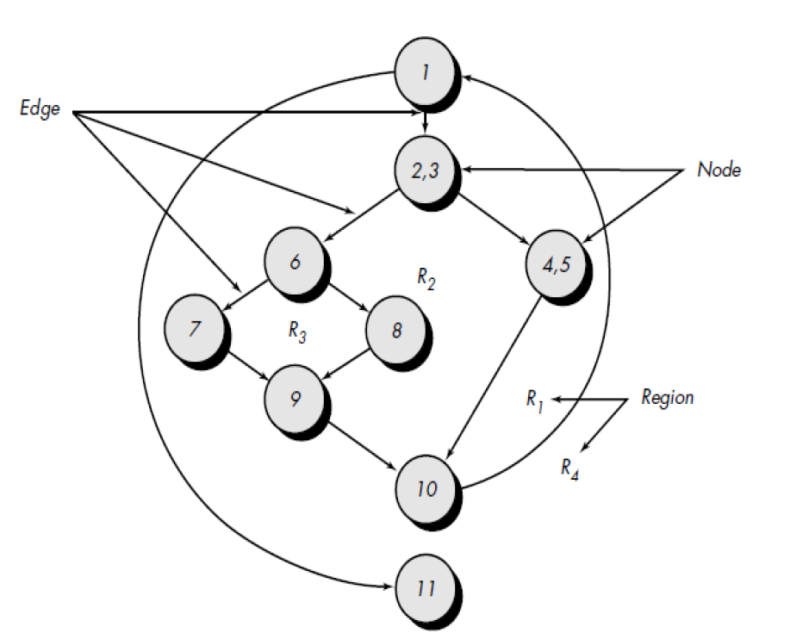
Problem 4
Find the Cyclomatic Complexity for the Control flow graph
Paths
• path 1: 1-11
• path 2: 1-2-3-4-5-10-1-11
• path 3: 1-2-3-6-8-9-10-1-11
• path 4: 1-2-3-6-7-9-10-1-11

Slide 52
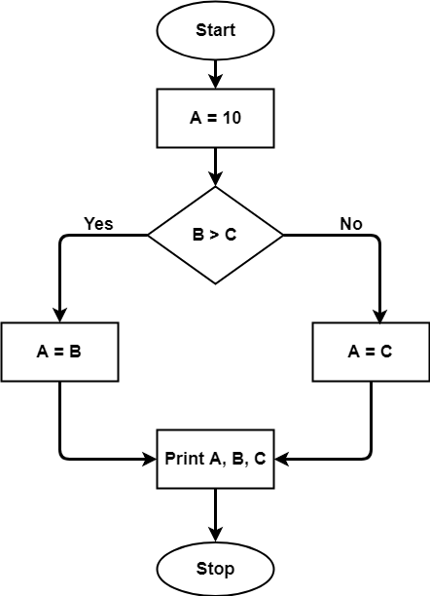
Problem 5

Slide 53
Graph Matrix
A graph matrix is a square matrix whose size (i.e., number of rows and columns) is equal to the number of nodes on the flow graph.
Each row and column corresponds to an identified node, and matrix entries correspond to connections (an edge) between nodes.
A simple example of a flow graph and its corresponding graph matrix
Each node on the flow graph is identified by numbers, while each edge is identified by letters.
A letter entry is made in the matrix to correspond to a connection between two nodes. node 3 is connected to node 4 by edge b
The graph matrix is nothing more than a tabular representation of a flow graph. by adding a link weight to each matrix entry, the graph matrix can become a powerful tool for evaluating program control structure during testing.

Slide 54
Graph Matrix
The link weight provides additional information about control flow form, the link weight is 1 (a connection exists) or 0 (a connection does not exist).
Each letter has been replaced with a 1, indicating that a connection exists (zeros have been excluded for clarity).Represented in this form, the graph matrix is called a connection matrix.
Each row with two or more entries represents a predicate node. Therefore, performing the arithmetic shown to the right of the connection matrix provides us with still another method for determining cyclomatic complexity

Slide 55
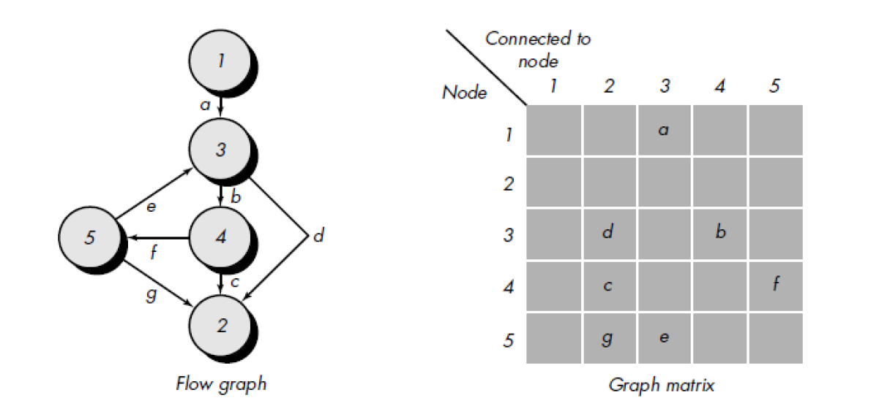
Graph Matrix

Slide 56
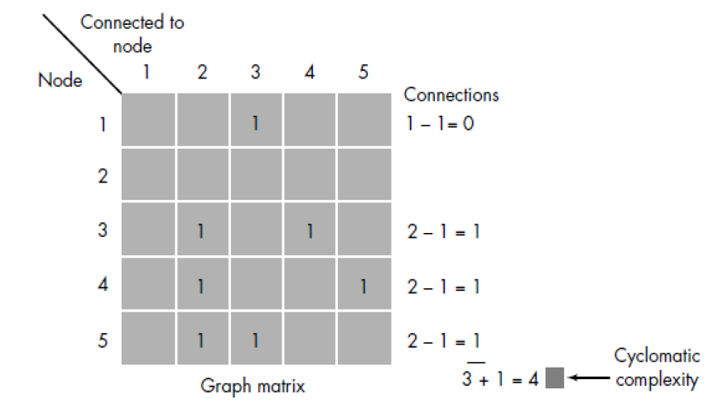
Connection Matrix

Slide 57
Control Structure Testing
Control structure testing is used to increase the coverage area by testing various control structures present in the program. The different types of testing performed under control structure testing are as follows
Condition Testing
Data flow Testing
Loop Testing

Slide 58
Condition Testing
It is a test cased design method, which ensures that the logical condition and decision statements are free from errors.
The errors present in logical conditions can be incorrect boolean operators, missing parenthesis in a booleans expression, error in relational operators, arithmetic expressions, and so on.

Slide 59
Condition Testing
The common types of logical conditions that are tested using condition testing are-
A relation expression, like E1 op E2 where ‘E1’ and ‘E2’ are arithmetic expressions and ‘OP’ is an operator.
A simple condition like any relational expression preceded by a NOT (~) operator. For example, (~E1) where ‘E1’ is an arithmetic expression and ‘~’ denotes NOT operator.
A compound condition consists of two or more simple conditions, Boolean operator For example, (E1 & E2)|(E2 & E3) where E1, E2, E3 denote arithmetic expression and ‘&’ and ‘|’ denote AND or OR operators.
A Boolean expression consists of operands and a Boolean operator like ‘AND’, OR, NOT. For example, ‘A|B’ is a Boolean expression where ‘A’ and ‘B’ denote operands and | denotes OR operator.

Slide 60
Data Flow Testing
The data flow testing method selects test paths of a program according to the locations of definitions and uses of variables in the program
It is a form of structural testing and a White Box testing technique that focuses on program variables and the paths:
From the point where a variable, v, is defined or assigned a value
To the point where that variable, v, is used

Slide 61
Data Flow Testing
Advantage:
To find a variable that is used but never defined,
To find a variable that is defined but never used,
To find a variable that is defined multiple times before it is use,
Disadvantage:
Time consuming and costly process
Requires knowledge of programming languages

Slide 62
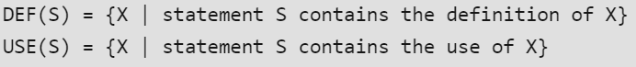
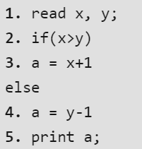
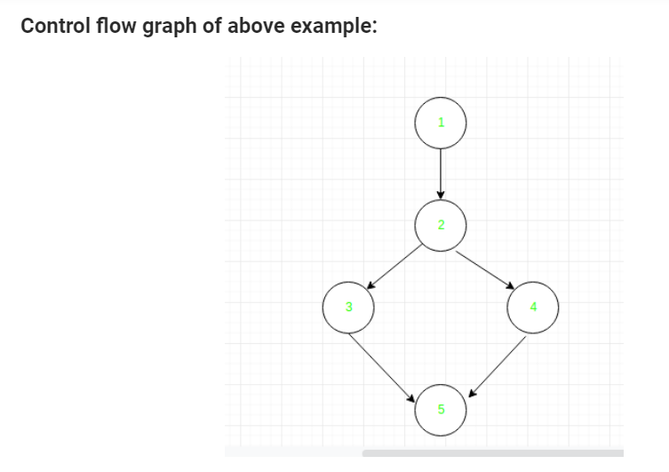
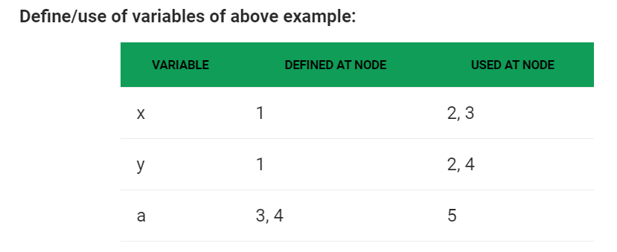
Data Flow Testing

Slide 63
Data Flow Testing
predicate use (p-use) for a variable that indicates its role in a predicate.
computational use (c-use) indicates the variable’s role as a part of a computation. In both cases the variable value is unchanged.
A definition-use(DU) chain of variable X is of the form [X.S.S’], where S and S’ are statement numbers, X is in DEF(S) and USE(S’).
One Simple data flow testing strategy is to require that every DU chain be covered at least once.
This strategy is DU Testing Strategy
For example, in the statement
Y = 26 * X ,the variable X is used. Specifically it has a c-use.
In the statement if (X= 98)
Y =max , X has a predicate or p-use.

Slide 64
Loop Testing
Loop testing is a white-box testing technique that focuses exclusively on the validity of loop constructs.
Four different classes of loops can be defined:
Simple loops
concatenated loops
nested loops
unstructured loops

Slide 65
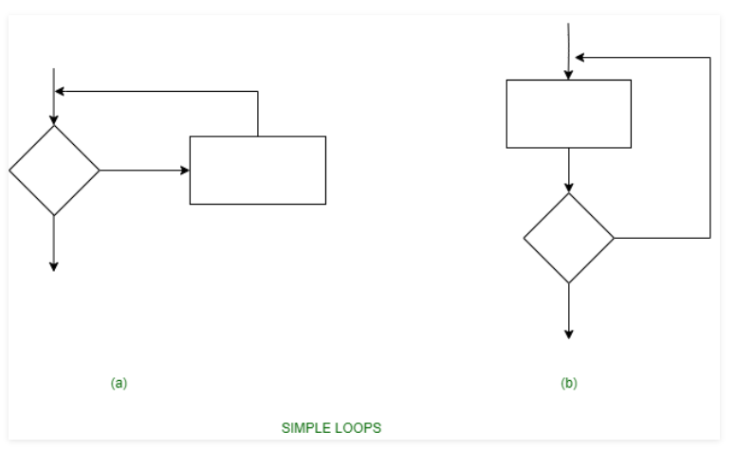
Simple Loop
The following set of test can be applied to simple loops, where the maximum allowable number through the loop is n.
Skip the entire loop.
Traverse the loop only once.
Traverse the loop two times.
Make p passes through the loop where p<n.
Traverse the loop n-1, n, n+1 times.

Slide 66
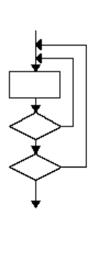
Nested Loop
Loops within loops are called as nested loops. when testing nested loops, the number of tested increases as level nesting increases. The following steps for testing nested loops are as follows
Start with inner loop. set all other loops to minimum values.
Conduct simple loop testing on inner loop.
Work outwards.
Continue until all loops tested.

Slide 67
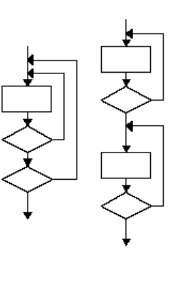
Concatenated Loop
If loops are not dependent on each other, contact loops can be tested using the approach used in simple loops.
If the loops are interdependent, the steps are followed in nested loops.

Slide 68
Unstructured Loop
To test the unstructured loops we needs to restructure their design.

Slide 69
Black Box Testing(Behavioral Testing)
Black box testing is a technique of software testing which examines the functionality of software without peering into its internal structure or coding.
The primary source of black box testing is a specification of requirements that is stated by the customer.
In this method, tester selects a function and gives input value to examine its functionality, and checks whether the function is giving expected output or not.
If the function produces correct output, then it is passed in testing, otherwise failed.
The test team reports the result to the development team and then tests the next function.
After completing testing of all functions if there are severe problems, then it is given back to the development team for correction.

Slide 70
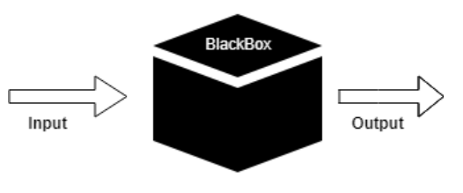
Black Box Testing

Slide 71
Black Box Testing Techniques:
Used to pick the test cases in a systematic manner
Using the below technique we could save lot of testing time and get the good test coverage.
Equivalence Partitioning
Boundary Value Analysis
Decision Table
State Transition

Slide 72
Equivalance Class Partitioning:
Inputs to the software or system are divided into groups that are expected to exhibit similar behaviour, so they are likely to be proposed in the same way.
Hence selecting one input from each group to design the test cases.
If a condition in a partition is valid, other conditions are valid too.
If a condition in a partition is invalid, other conditions are invalid too

Slide 73
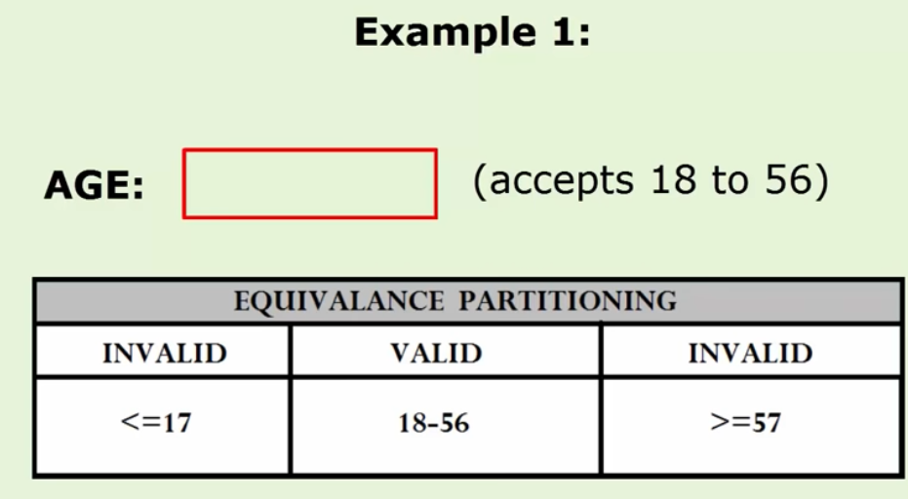
Equivalance Class Partitioning:

Slide 74
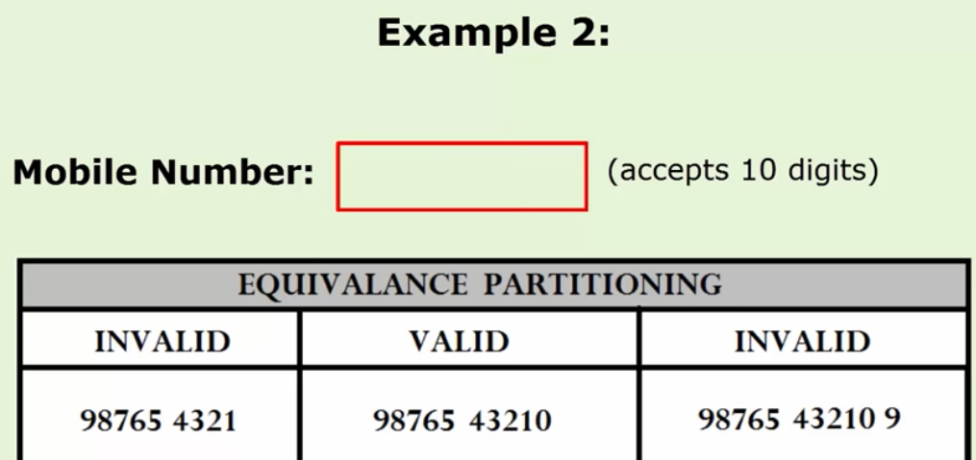
Equivalance Class Partitioning:

Slide 75
Boundary Value Analysis:
Based on testing the boundary values of valid and invalid partitions
Every partition has its maximum and minimum values and these max and min values are the boundary values of the partition
A boundary value for a valid partition is a valid boundary value.
A boundary value for an invalid partition is an invalid boundary value.

Slide 76
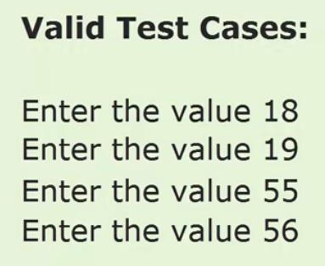
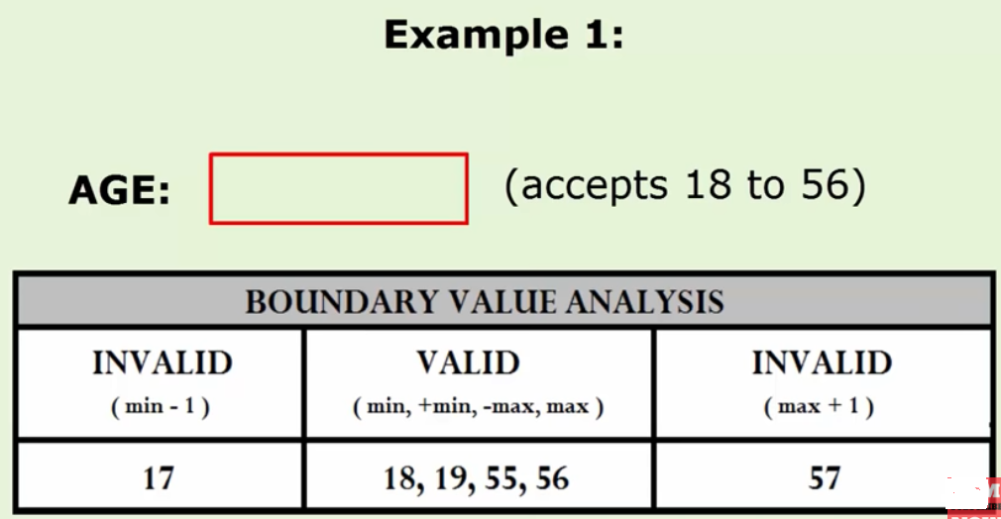
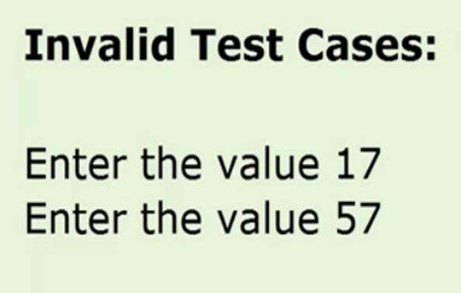
Boundary Value Analysis

Slide 77
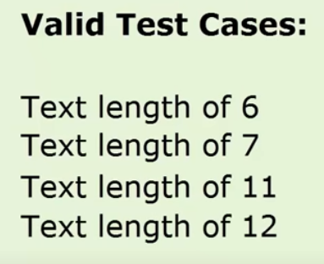
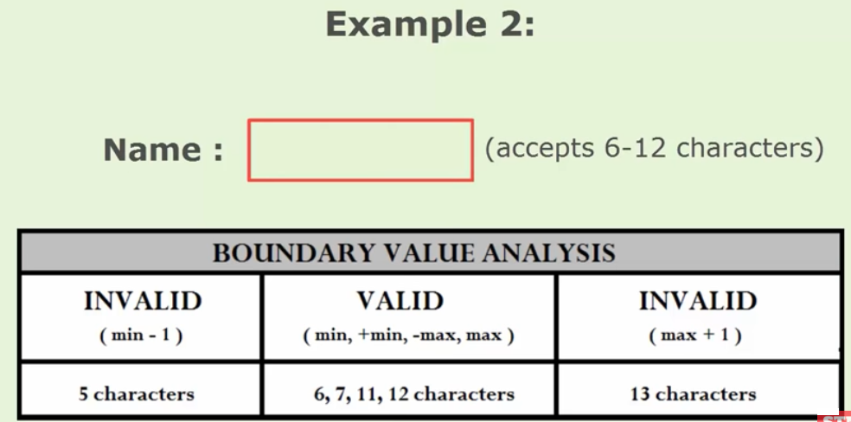
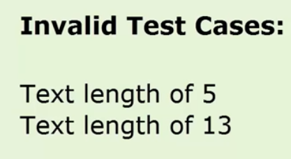
Boundary Value Analysis:

Slide 78
Decision Table testing:
It deals with condition and action
Eg. Login Validation
Eg. Online Money transfer

Slide 79
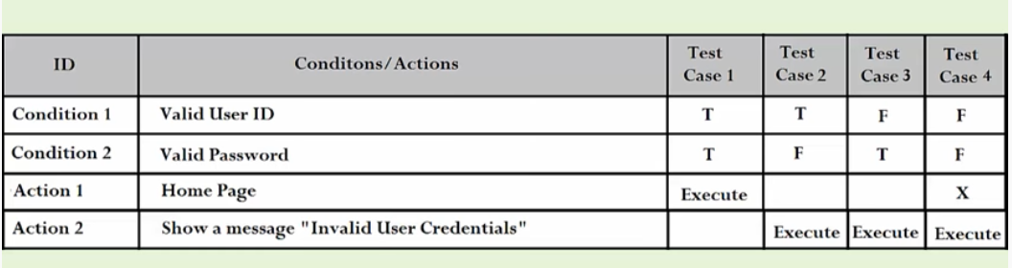
Decision Table testing:

Slide 80
Decision Table testing:

Slide 81
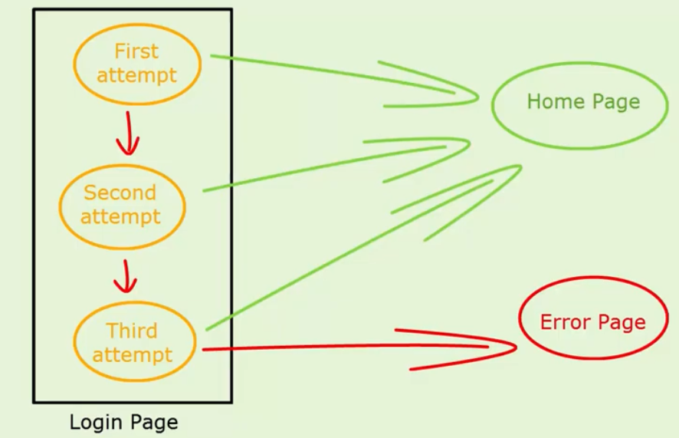
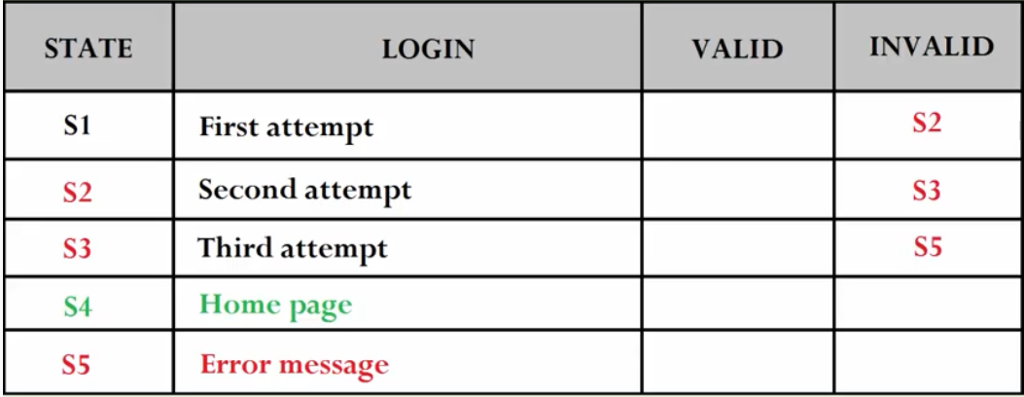
State Transition Testing:Login page of an application

Slide 82
Test Case
A test case is a document, which has a set of test data, preconditions, expected results and postconditions, developed for a particular test scenario in order to verify compliance against a specific requirement.

Slide 83
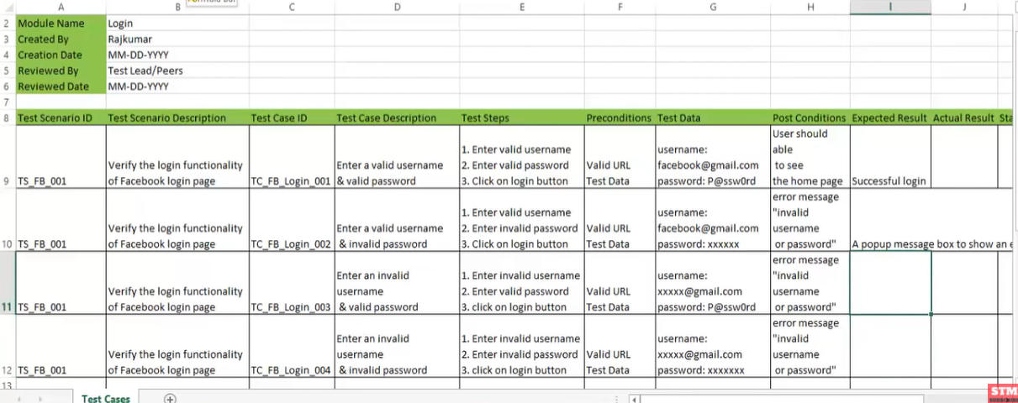
Test Case

Slide 84
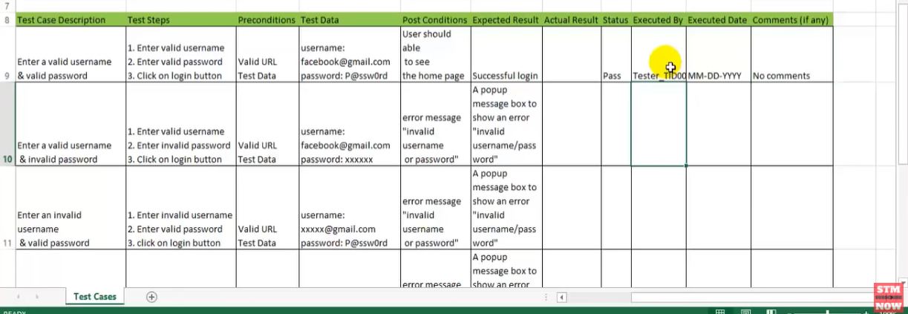
Test Case

Slide 85
Software Testing Strategies
Testing begins at module level and works outward towards the integration of entire computer based system.
Different testing techniques are required at different points in time.
Testing is conducted by the s/w developer and ITG( Independent Test Group ) for large projects.
Testing and Debugging are different and Debugging is essential in any testing strategy.
Technically Testing is a process to check if the application is working same as it was supposed to do, and not working as it was not supposed to do.
On other hand Debugging is the activity performed by developers to fix the bug found in the system.

Slide 86
Verification and Validation
Verification is the process of evaluating a software system or component to determine whether the products of a given development phase satisfy the conditions imposed at the start of that phase .
Does the product meet its specifications?
Are we building the product right?
Methods of Verification : Static Testing
Walkthrough
Inspection
Review

Slide 87
Verification and Validation
Validation is the process of evaluating a software system or component during, or at the end of, the development cycle in order to determine whether it satisfies specified requirements
Does the product perform as desired?
Are we building the right product
Methods of Validation : Dynamic Testing
Testing

Slide 88
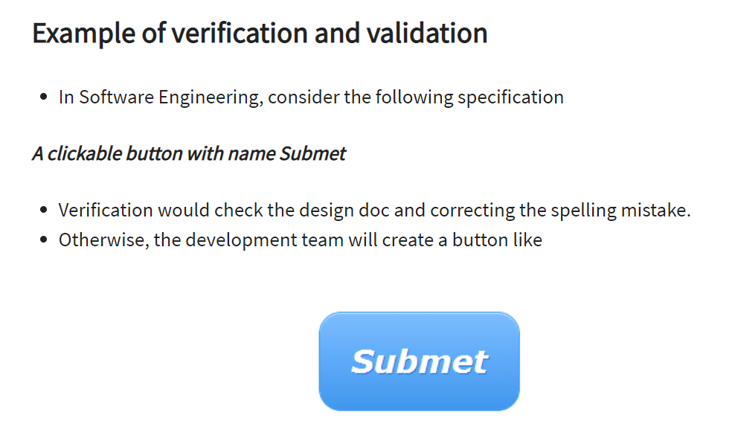

Slide 89
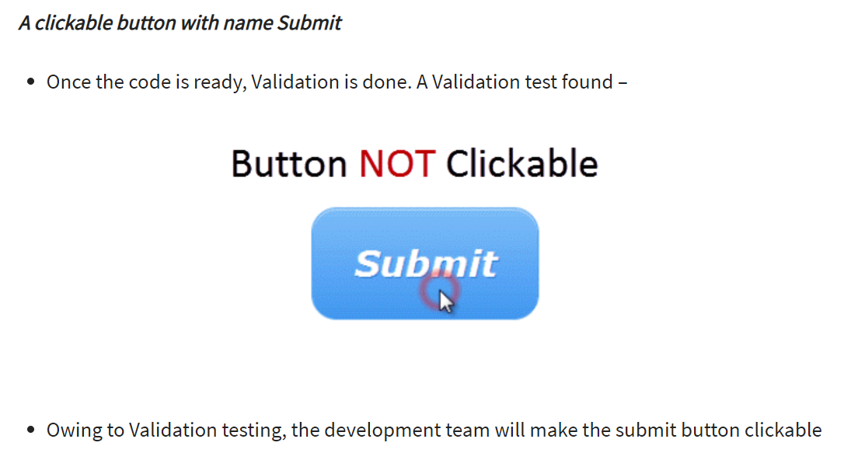
Example for Verification and Validation

Slide 90
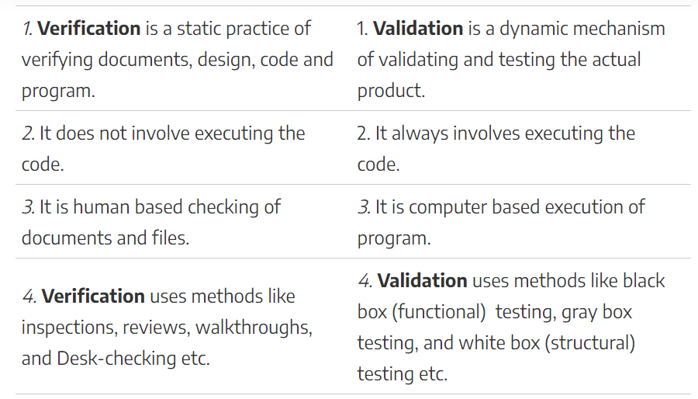
Difference between Verification and Validation

Slide 91
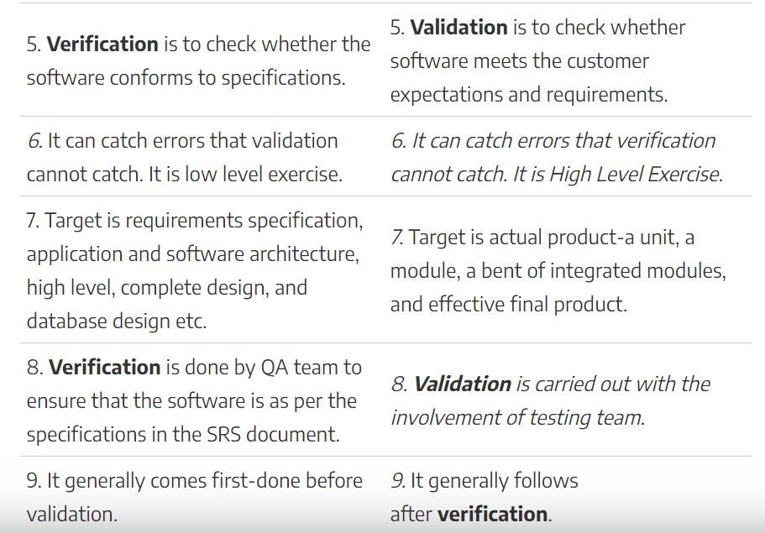
Difference between Verification and Validation

Slide 92
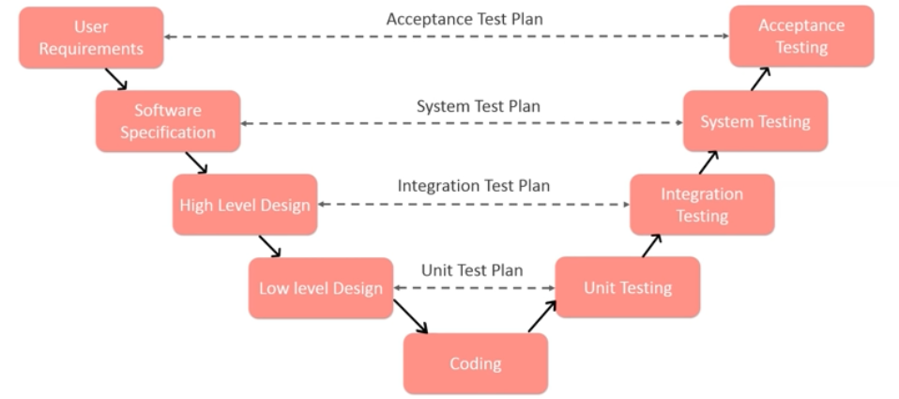
Verification and Validation

Slide 93


Level of Software Testing[White Box Testing]

Slide 94


Level of Software Testing

Slide 95

Level of Software Testing

Slide 96
Unit Testing
Unit testing involves the testing of each unit or an individual component of the software application.
It is the first level of functional testing.
The aim behind unit testing is to validate unit components with its performance.
The purpose of unit testing is to test the correctness of isolated code.
A unit component is an individual function or code of the application.
White box testing approach used for unit testing and usually done by the developers.
Whenever the application is ready and given to the Test engineer, he/she will start checking every component of the module or module of the application independently or one by one, and this process is known as Unit testing or components testing.

Slide 97

Why Unit Testing
In a testing level hierarchy, unit testing is the first level of testing done before integration and other remaining levels of the testing.
It uses modules for the testing process which reduces the dependency of waiting for Unit testing frameworks, stubs, drivers and mock objects are used for assistance in unit testing.

Slide 98
Why Unit Testing
Unit testing helps tester and developers to understand the base of code that makes them able to change defect causing code quickly.
Unit testing helps in the documentation.
Unit testing fixes defects very early in the development phase that's why there is a possibility to occur a smaller number of defects in upcoming testing levels.
It helps with code reusability by migrating code and test cases.

Slide 99
Scenario-Online Banking Application

Slide 100

Scenario-Online Banking Application

Slide 101

Scenario-Online Banking Application[Unit Testing]

Slide 102
Integration Testing
Integration testing is the second level of the software testing process comes after unit testing.
In this testing, units or individual components of the software are tested in a group.
The focus of the integration testing level is to expose defects at the time of interaction between integrated components or units.
It uses modules for testing purpose, and these modules are combined and tested in integration testing.
The Software is developed with a number of software modules that are coded by different coders or programmers.
The goal of integration testing is to check the correctness of communication among all the modules.

Slide 103

Integration Testing

Slide 104

Integration Testing
Once all the components or modules are working independently, then we need to check the data flow between the dependent modules is known as integration testing.
one sample example of a banking application

Slide 105
Scenario 1:
First, we will login as a user P to amount transfer and send Rs200 amount, the confirmation message should be displayed on the screen as amount transfer successfully.
Now logout as P and login as user Q and go to amount balance page and check for a balance in that account = Present balance + Received Balance.
Therefore, the integration test is successful.
Also, we check if the amount of balance has reduced by Rs200 in P user account.
Click on the transaction, in P and Q, the message should be displayed regarding the data and time of the amount transfer.

Slide 106
Guidelines for Integration Testing
we go for the integration testing only after the functional testing is completed on each module of the application.
We always do integration testing by picking module by module so that a proper sequence is followed, and also we don't miss out on any integration scenarios.
First, determine the test case strategy through which executable test cases can be prepared according to test data.
Examine the structure and architecture of the application and identify the crucial modules to test them first and also identify all possible scenarios.
Design test cases to verify each interface in detail.
Choose input data for test case execution. Input data plays a significant role in testing.
If we find any bugs then communicate the bug reports to developers and fix defects and retest.

Slide 107
Guidelines for Integration Testing
Here positive testing implies that if the total balance is Rs15, 000 and we are transferring Rs1500 and checking if the amount transfer works fine. If it does, then the test would be a pass.
And negative testing means, if the total balance is Rs15, 000 and we are transferring Rs20, 000 and check if amount transfer occurs or not, if it does not occur, the test is a pass. If it happens, then there is a bug in the code, and we will send it to the development team for fixing that bug.

Slide 108

Scenario 2:Gmail Application
First, we login as P users and click on the Compose mail and performing the functional testing for the specific components.
Now we click on the Send and also check for Save Drafts.
After that, we send a mail to Q and verify in the Send Items folder of P to check if the send mail is there.
Now, we will log out as P and login as Q and move to the Inbox and verify that if the mail has reached.

Slide 109

Types of Integration Testing

Slide 110
Incremental Approach
In the Incremental Approach, modules are added in ascending order one by one or according to need.
The selected modules must be logically related.
Generally, two or more than two modules are added and tested to determine the correctness of functions.
The process continues until the successful testing of all the modules.

Slide 111
Incremental Approach
For example: Suppose we have a Flipkart application, we will perform incremental integration testing, and the flow of the application would like this:
Flipkart→ Login→ Home → Search→ Add cart→Payment → Logout
Incremental integration testing is carried out by further methods:
Top-Down approach
Bottom-Up approach

Slide 112

Scenario 1
The development team develops the application and sends it to the CEO of the testing team.
The order from the CEO to the test engineer is top-down incremental integrating testing.
When the test engineers are done with testing, they send a report to the test leads, who then submit a report to the manager, and the manager will send a report to the CEO.
This process is known as Bottom-up incremental integration testing

Slide 113
Stub and Driver
stubs and drivers refers to the replica of the modules, which acts as a substitute to the undeveloped or missing module
Stubs are used to test modules and are created by the team of testers during the process of Top Down Integration Testing
With the assistance of these test stubs testers are capable of stimulating the behaviour of the lower level modules that are not yet integrated with the software.
Drivers are used for Bottom up Integration Testing
Module-A ->Login page of the web application.
Module-B → Home page of the web application.
Module-C → Print Setup.
Module-D → Log out page.
modules A, B, C & D involves the interdependencies of each module over other.

Slide 114

System Testing
System testing is actually a series of different tests whose primary purpose is to fully exercise the computer-based system.

Slide 115

Acceptance Testing
Acceptance test is a level of software testing where a system is tested for acceptability.
Focus of acceptance test is not to find defects but to check whether the system meets their requirements
Acceptance Testing can be done in 2 ways
Alpha Testing
Beta Testing

Slide 116
Acceptance Testing-Alpha and Beta Testing
The alpha test is conducted at the developer's site by a customer.
The software is used in a natural setting with the developer "looking over the shoulder" of the user and recording errors and usage problems.
Alpha tests are conducted in a controlled environment.
The beta test is conducted at one or more customer sites by the end-user of the software. Unlike alpha testing, the developer is generally not present.
Therefore, the beta test is a "live" application of the software in an environment that cannot be controlled by the developer.
The customer records all problems that are encountered during beta testing and reports these to the developer at regular intervals.
As a result of problems reported during beta tests, software engineers make modifications and then prepare for release of the software product to the entire customer base.

Slide 117
Regression Testing
Re-executing all prior tests after a code change
often done by scripts, automated testing
used to ensure that old fixed bugs are still fixed
a new feature or a fix for one bug can cause a new bug or reintroduce an old bug
especially important in evolving object-oriented systems

Slide 121
When to Apply Regression Testing
When a change request (CR) is raised by the client, which leads to change in the code-base.
When there is a change in the testing environment.
When back-end code is migrated to a different platform.
Critical bug(s) is found during the testing phase and is fixed by the developer.
A new feature is added to an existing application.
The major concerns about performance issues and crashes are fixed by the developers.
Patch fixes are added.
The UI of the application was changed for better user experience.

Slide 122
When to Apply Regression Testing

Slide 128
Smoke Test
Check basic functionality of software
Daily/nightly build Software is compiled, linked and (re)tested on a daily Basis “Good” build if pass all smoke tests
Software components that have been translated into code are integrated into a “build”.
A build includes all data files, libraries, reusable modules, and engineered components that are required to implement one or more product functions.
Series of tests is designed to expose errors that will keep the build from properly performing its function.
The intent should be to uncover “show stopper” errors that have the highest likelihood of throwing the software project behind schedule.
The build is integrated with other builds and the entire product (in its current form) is smoke tested daily.
The integration approach may be top down or bottom up.

Slide 129

Smoke Test Cycle

Slide 130

Smoke Test-Example

Slide 131


Non Functional Testing

Slide 132



Non Functional Testing

Slide 133

Performance Testing
The testing to evaluate the response time (speed), throughput and utilization of system to execute its required functions in comparison with different versions of the same product or a different competitive product is called Performance Testing.
Performance testing is done to derive benchmark numbers for the system.
Heavy load is not applied to the system
Tuning is performed until the system under test achieves the expected levels of performance.

Slide 134
Security Testing
Security testing attempts to verify that protection mechanisms built into a system will, in fact, protect it from improper penetration. "The system's security must, of course, be tested for invulnerability from frontal attack” but must also be tested for invulnerability from flank or rear attack."
During security testing, the tester plays the role(s) of the individual who desires to penetrate the system

Slide 135
Stress Testing
Stress testing executes a system in a manner that demands resources in abnormal quantity, frequency, or volume.
special tests may be designed that generate ten interrupts per second, when one or two is the average rate,
input data rates may be increased by an order of magnitude to determine how input functions will respond,
test cases that require maximum memory or other resources are executed,
test cases that may cause thrashing in a virtual operating system are designed,
test cases that may cause excessive hunting for disk-resident data are created. Essentially, the tester attempts to break the program.

Slide 136
Configuration Review
The intent of the review is to ensure that all elements of the software configuration have been properly developed, are cataloged, and have the necessary detail to bolster the support phase of the software life cycle.

Slide 137
Load Testing
Process of exercising the system under test by feeding it the largest tasks it can operate with.
Constantly increasing the load on the system via automated tools to simulate real time scenario with virtual users.
Examples:
• Testing a word processor by editing a very large document.
• For Web Application load is defined in terms of concurrent users or HTTP connections

Slide 138
Debugging
Debugging is the process that results in the removal of the error.

Slide 139
Debugging
The debugging process begins with the execution of a test case. Results are assessed and a lack of correspondence between expected and actual performance is encountered.
In many cases, the noncorresponding data are a symptom of an underlying cause as yet hidden. The debugging process attempts to match symptom with cause, thereby leading to error correction.
The debugging process will always have one of two outcomes: (1) the cause will be found and corrected, or (2) the cause will not be found.

Slide 140

Debugging

